Slide 1
ANALYSIS OF Employee​ ​Satisfaction
ADVAIT KULKARNI SUHIT DATTA
VARAD TUPE

Slide 2
The following are the features in the dataset Human Resource Analytics dataset :
Field Name | Description
satisfaction_level | Level of satisfaction (0-1)
last_evaluation | Time since last performance evaluation (in Years)
number_project | Number of projects completed while at work
average_montly_hours | Average monthly hours at workplace
time_spend_company | Number of years spent in the company
Work_accident | Whether the employee had a workplace accident
left | Whether the employee left the workplace or not (1 or 0) Factor
promotion_last_5years | Whether the employee was promoted in the last five years
sales | Department in which they work for
salary | Relative level of salary (high, medium, low)

Slide 3
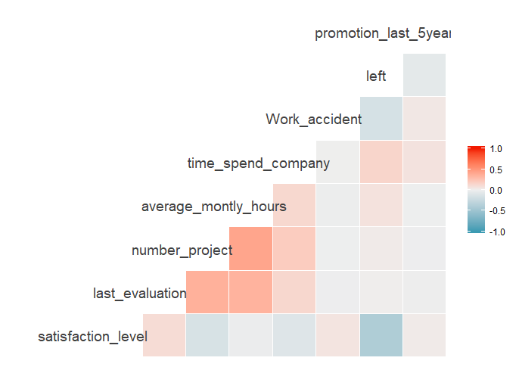
Correlation Plot

Slide 4
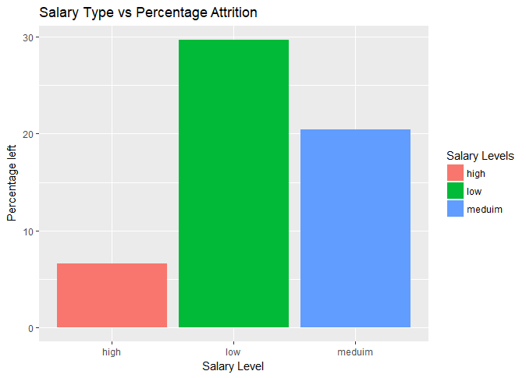
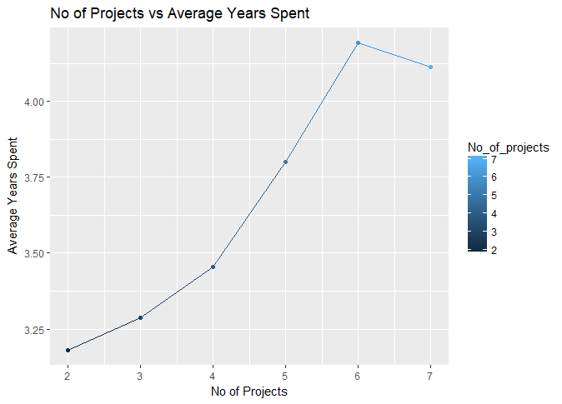
Relationship between No of Projects and the Average Years spent in the Company
Distribution of the Salary Category vs Attrition Percent

Slide 5
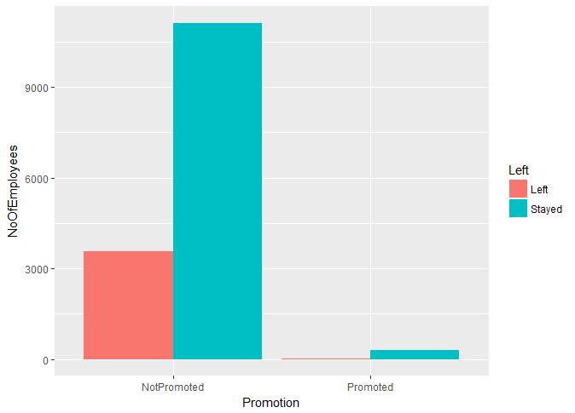
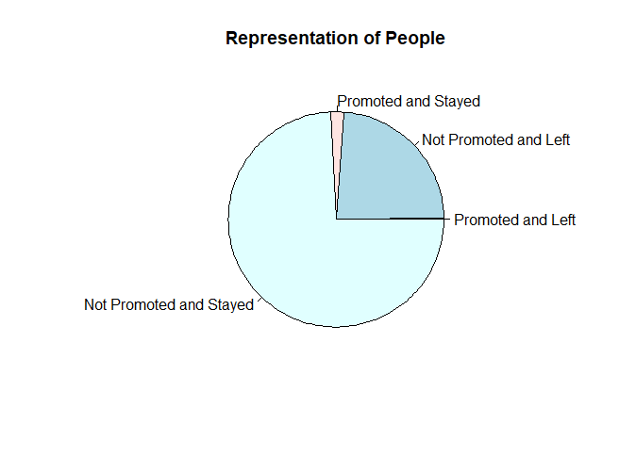
By Promotion in the last 5 years
Almost ¼ th of the people left !

Slide 6
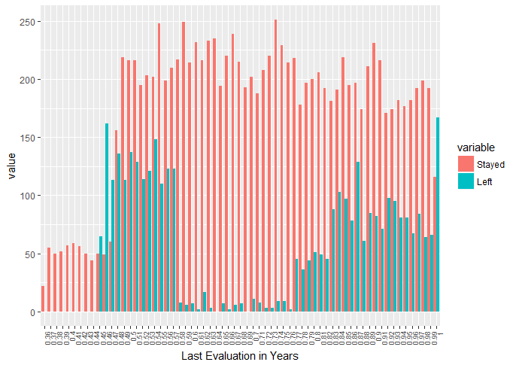
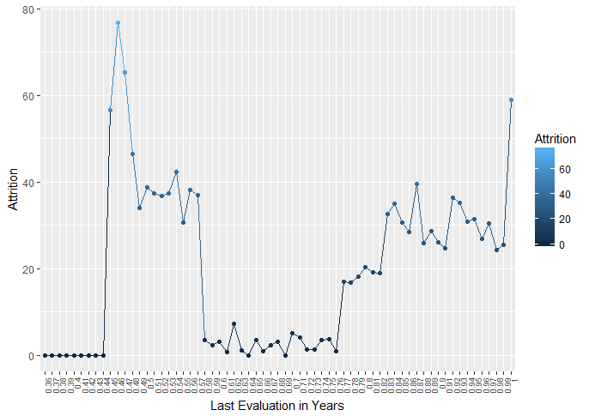
By Last Evaluation

Slide 7
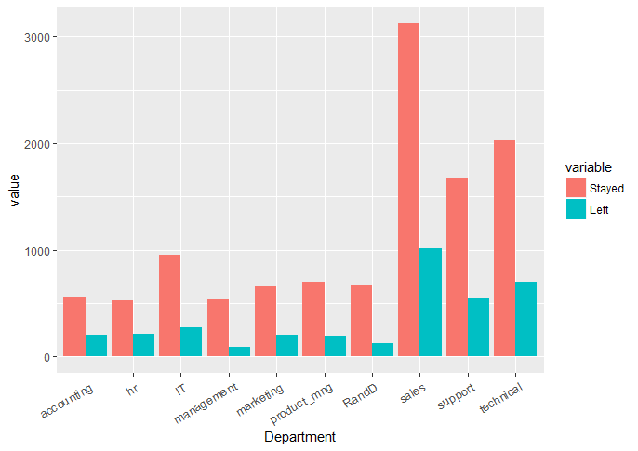
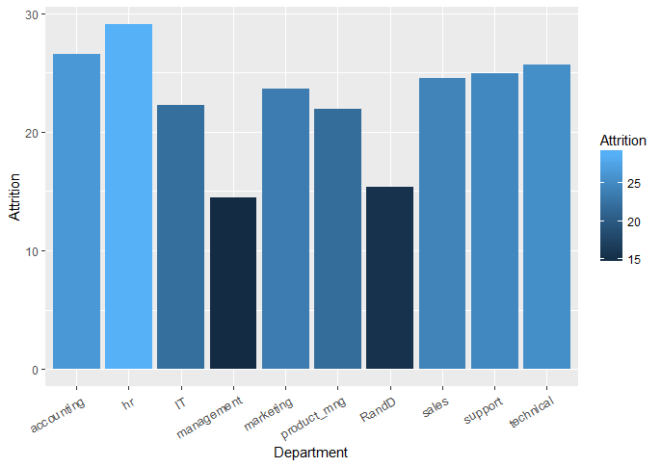
By Department

Slide 8
By Satisfaction Level
Satisfaction Level | Qualitative Equivalent
Greater than 0.8 | Very High
Between 0.6 and 0.8 | High
Between 0.4 and 0.6 | Medium
Between 0.2 and 0.4 | Low
Less than 0.2 | Very Low

Slide 9
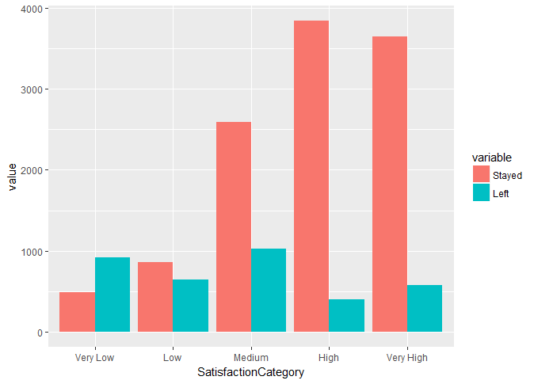
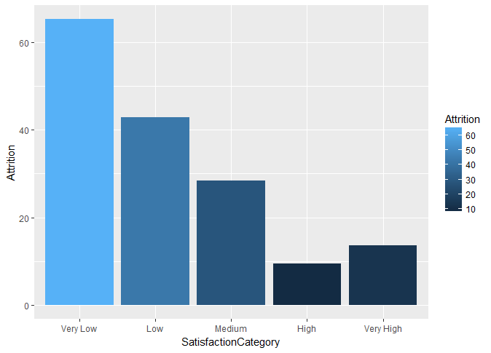

Slide 10
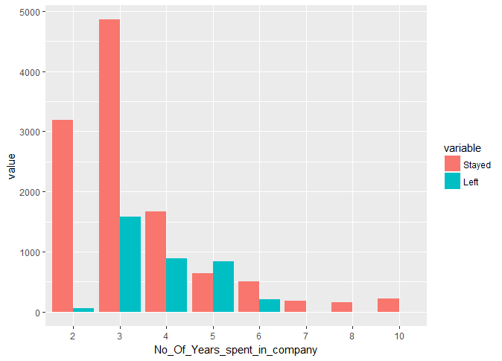
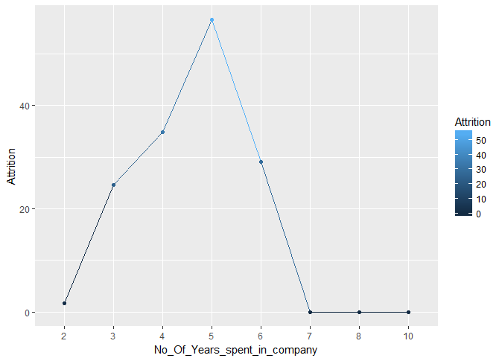
By Number of Years spent in the Company

Slide 11
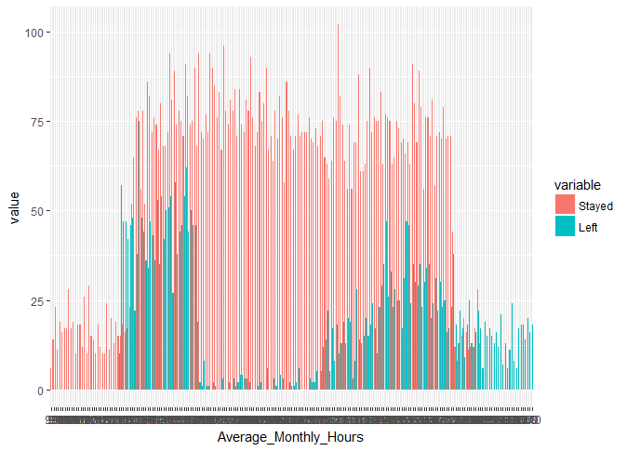
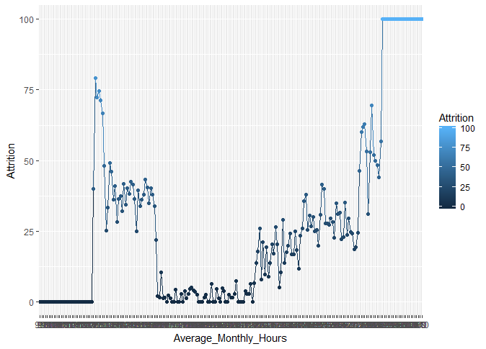
By Average monthly hours spent at Workplace

Slide 12
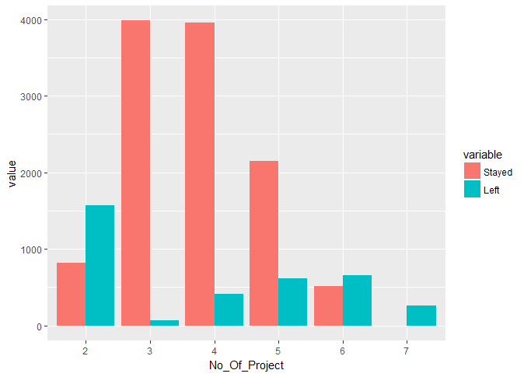
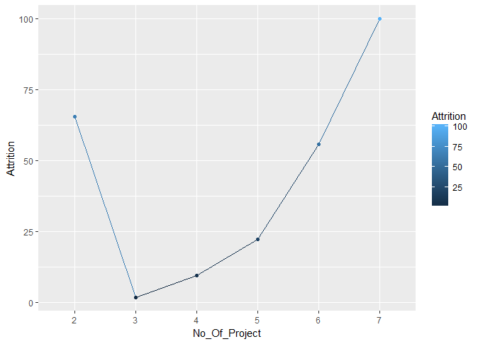
By Number of Projects

